Slide 1
Node JS Basic
ASYNCHRONOUS CALLBACK

Slide 2
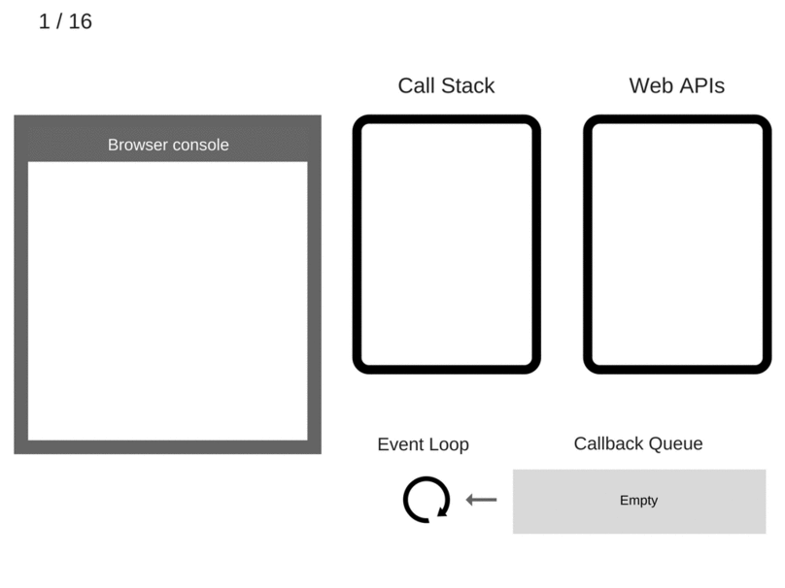
What’s Asynchronous in Javascript?

Slide 3
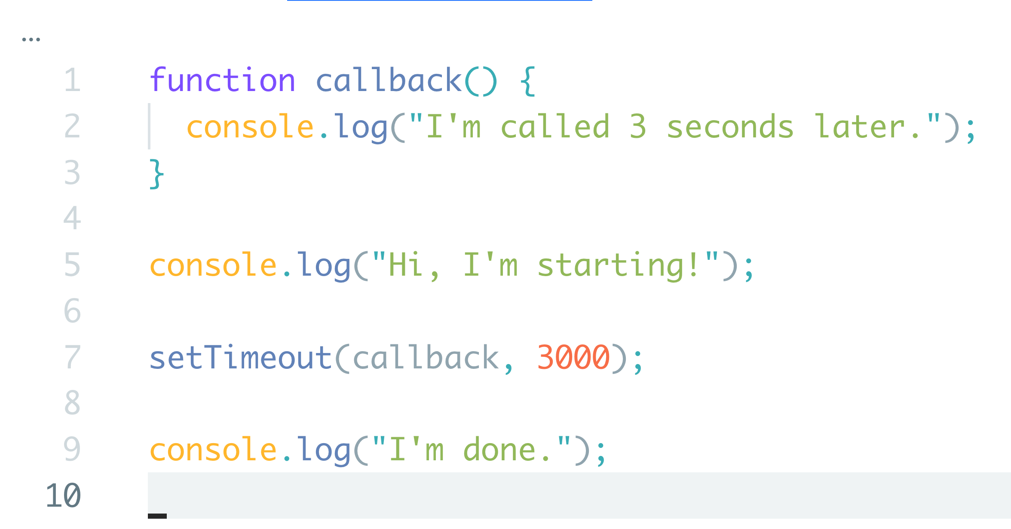
What’s Callback Function?
A function which will be called after code execution finishes.
A function which will also be called after certain period of time.
A way to handle asynchronous call.

Slide 4
Synchronous vs Asynchronous
Code executed at the same time.
Processes executed in sequence.
Outputs will always happened in sequence.
Finished after the whole process finishes.
Code may be executed at different times.
Processes executed in parallel.
Output from code execution will also happened in different times.
Finished at the last line of code, not always after the whole process finishes.

Slide 5
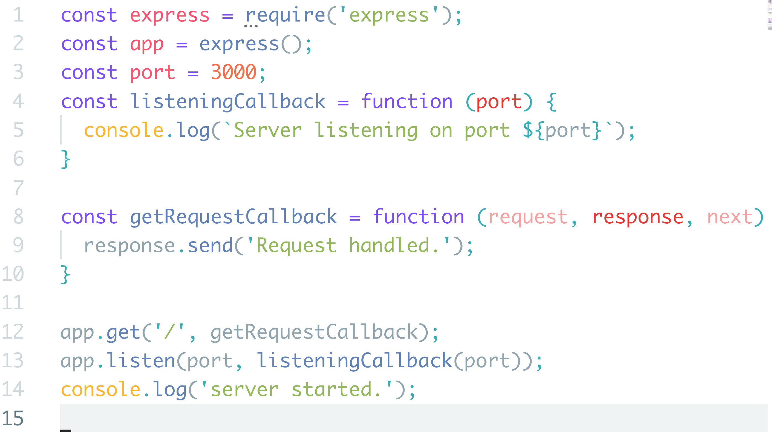
Callback in Asynchronous Calls

Slide 6
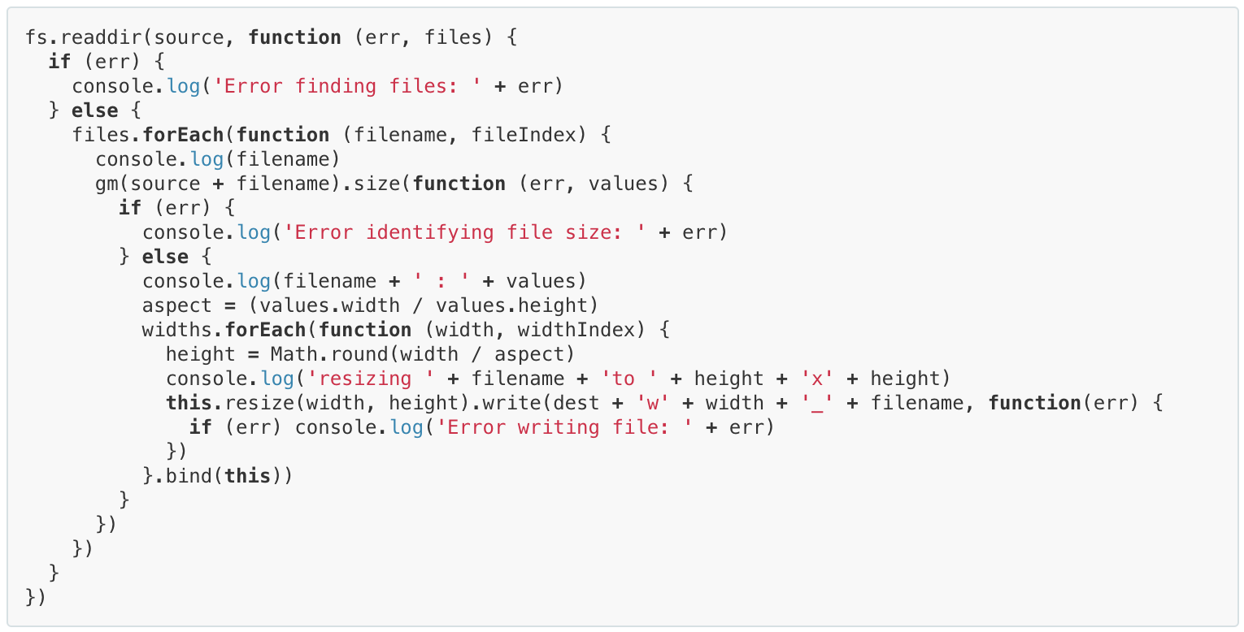
Callback Hell

Slide 7
Callback Hell
Reason:
You want to make code execution visually happens from the start to the end of your code.
Solutions:
Modularize
Promise
Generator function
Async/Await function

Slide 8

BETTER. CODE. NOW.

Slide 9
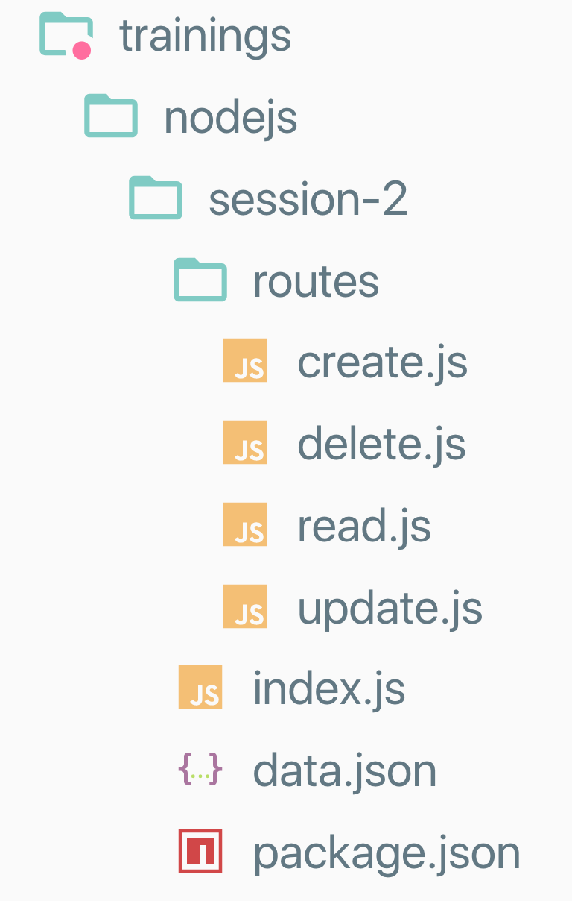
Simple API 2.0
Create your NPM project consisting:
routes (directory)
create.js
delete.js
read.js
update.js
index.js
data.json
package.json
hint: npm init -y

Slide 10
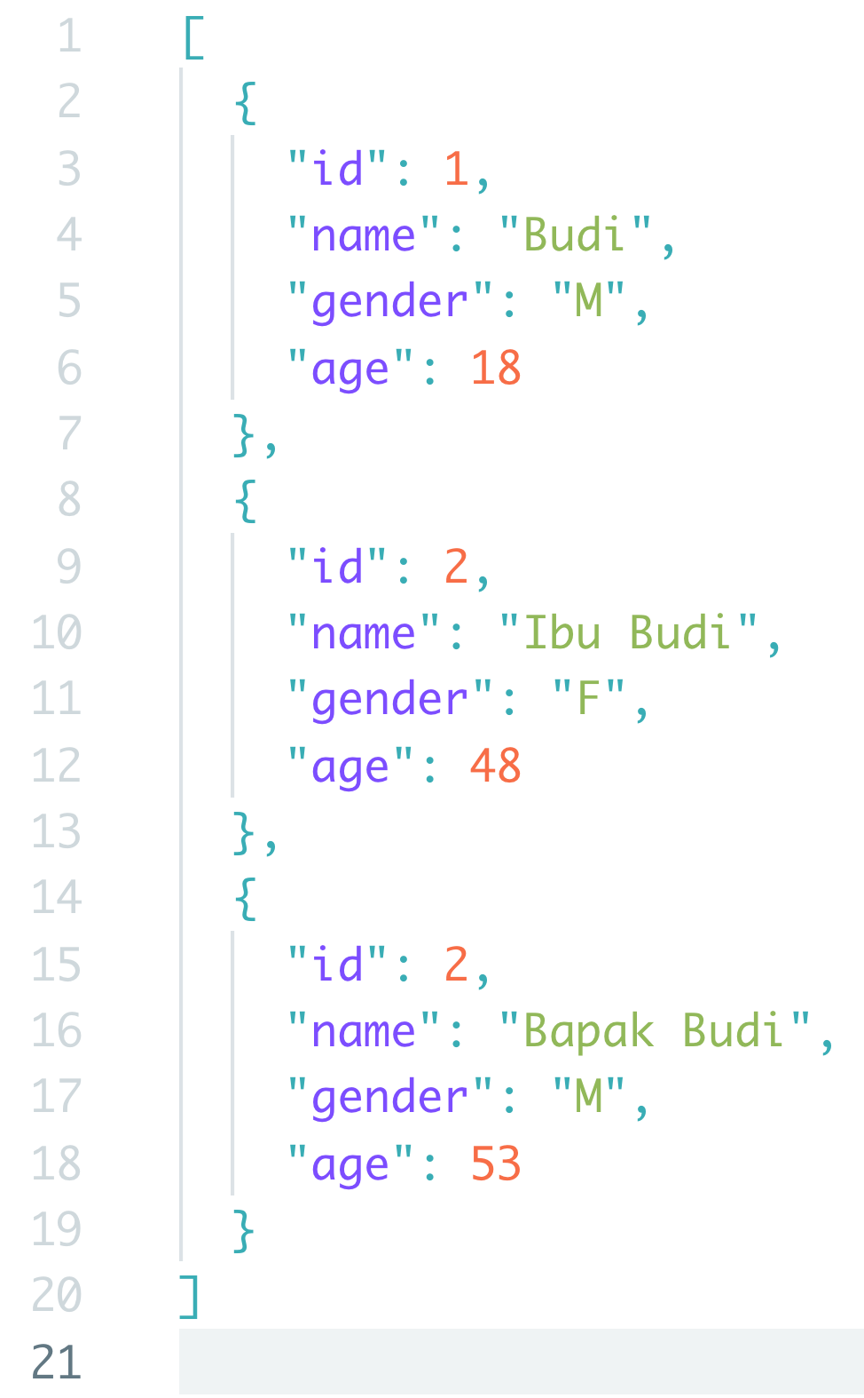
Simple API 2.0
Install the required packages:
express
body-parser
nodemon
Write into your data.json file a sample data, similar to the picture on the left.

Slide 11
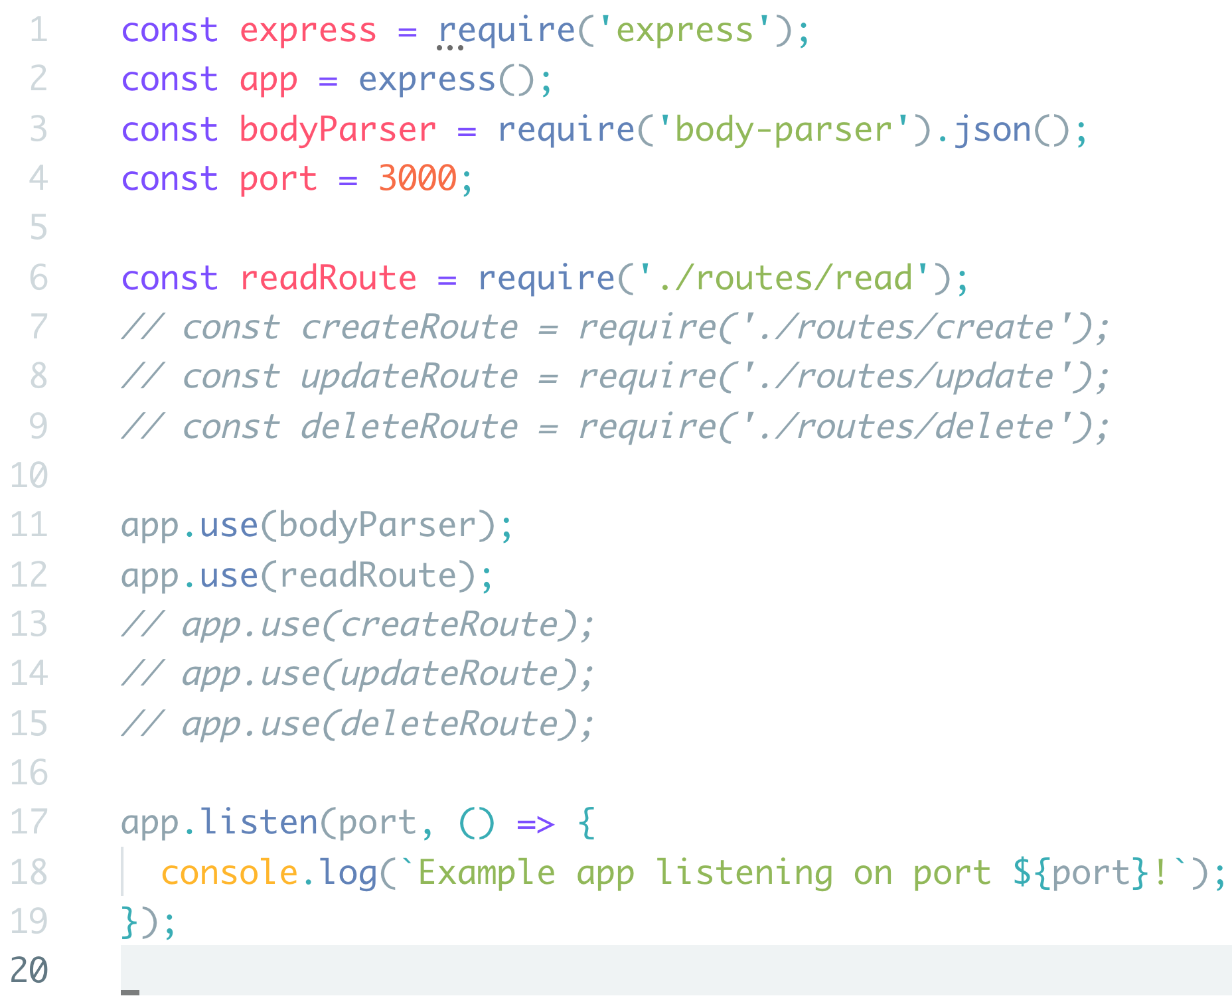
Simple API 2.0
Write code sample on the left into your index.js file
We will then continue to read.js file inside routes directory.

Slide 12
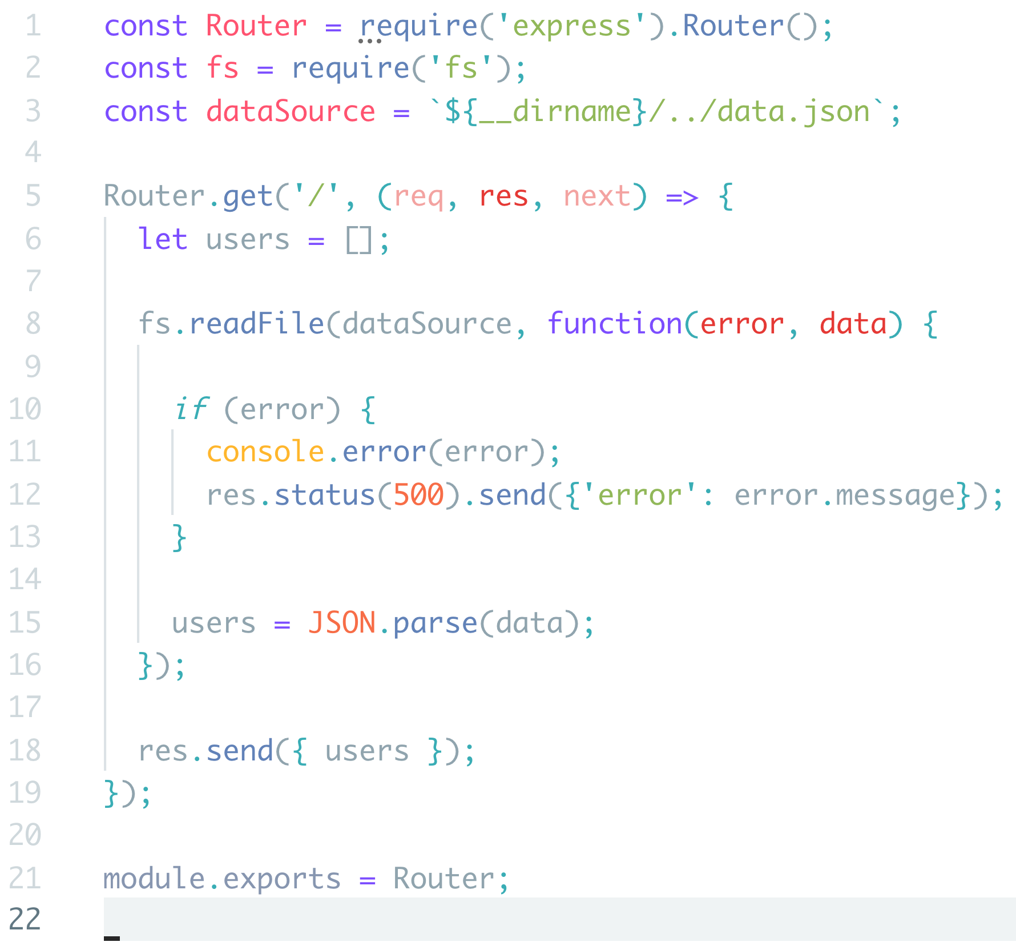
Simple API 2.0
Moving to read.js file, write the sample codes on the left.
Start your service.
> nodemon index.js
Did anyone manage to return all users to the response?
Did anyone encounter HTTP error 500?

Slide 13
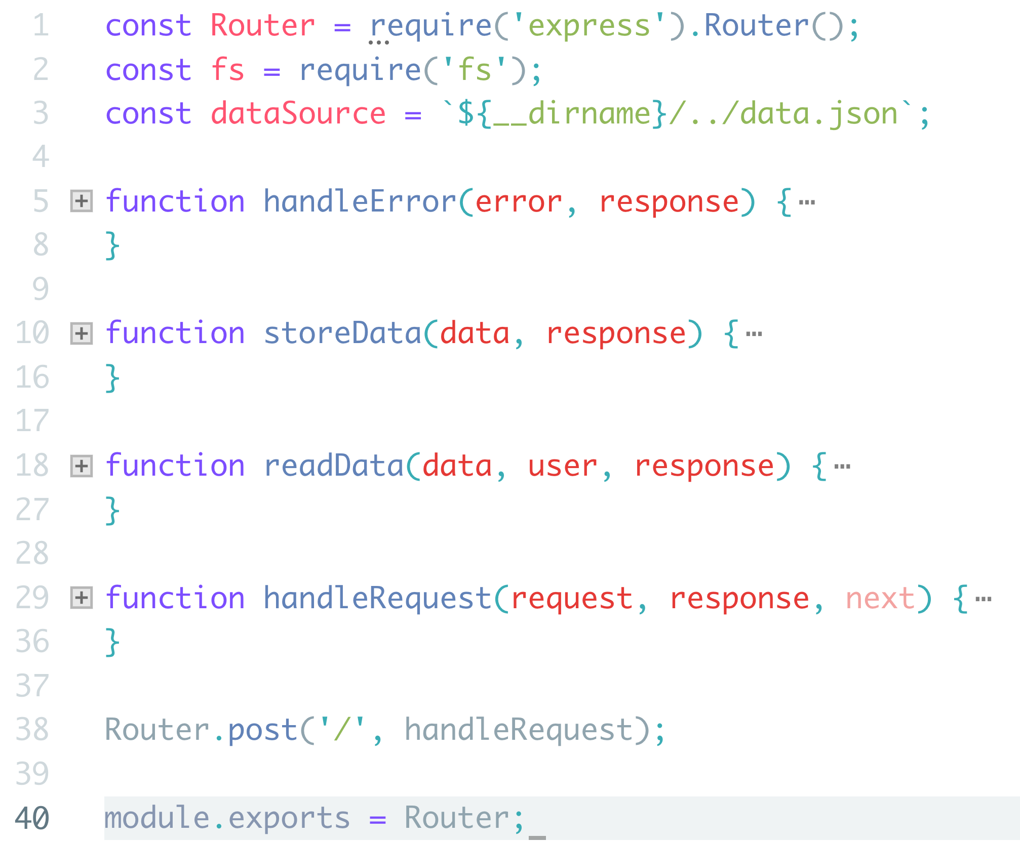
Simple API 2.0
Moving on to create.js route file.
Actions this endpoint will do:
Process HTTP POST Request.
Read data source file.
Push new user to the data source.
Rewrite data source file.
Handle any errors.

Slide 14
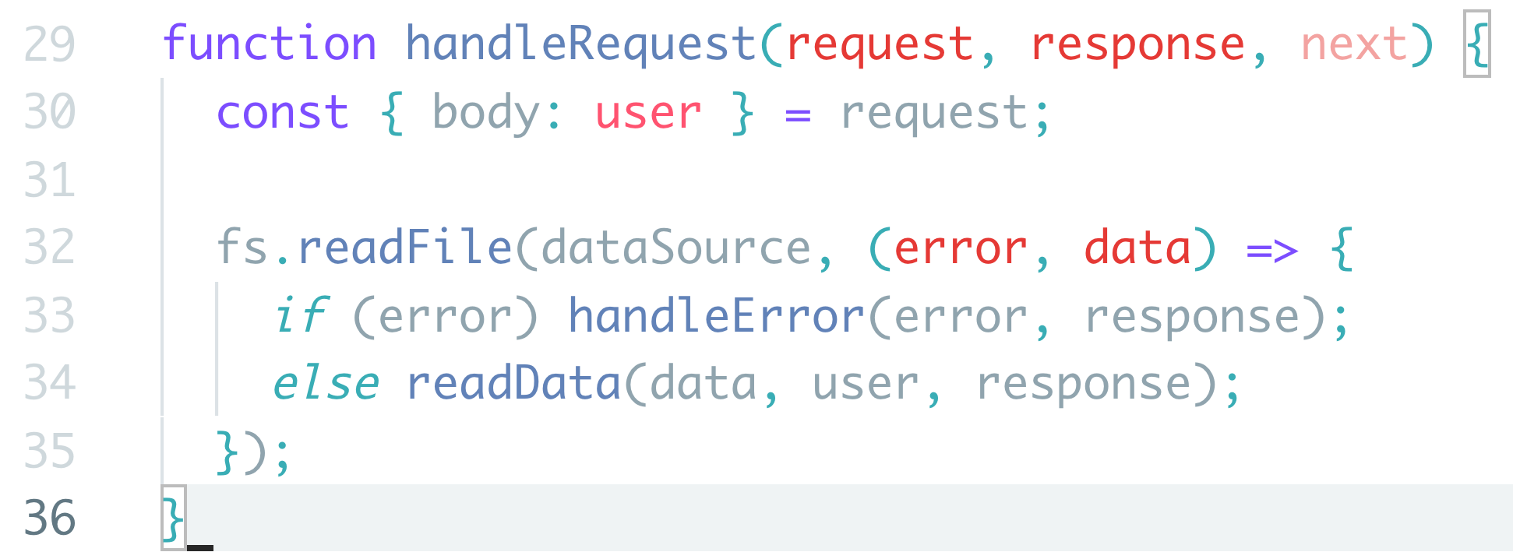
Simple API 2.0

Slide 15
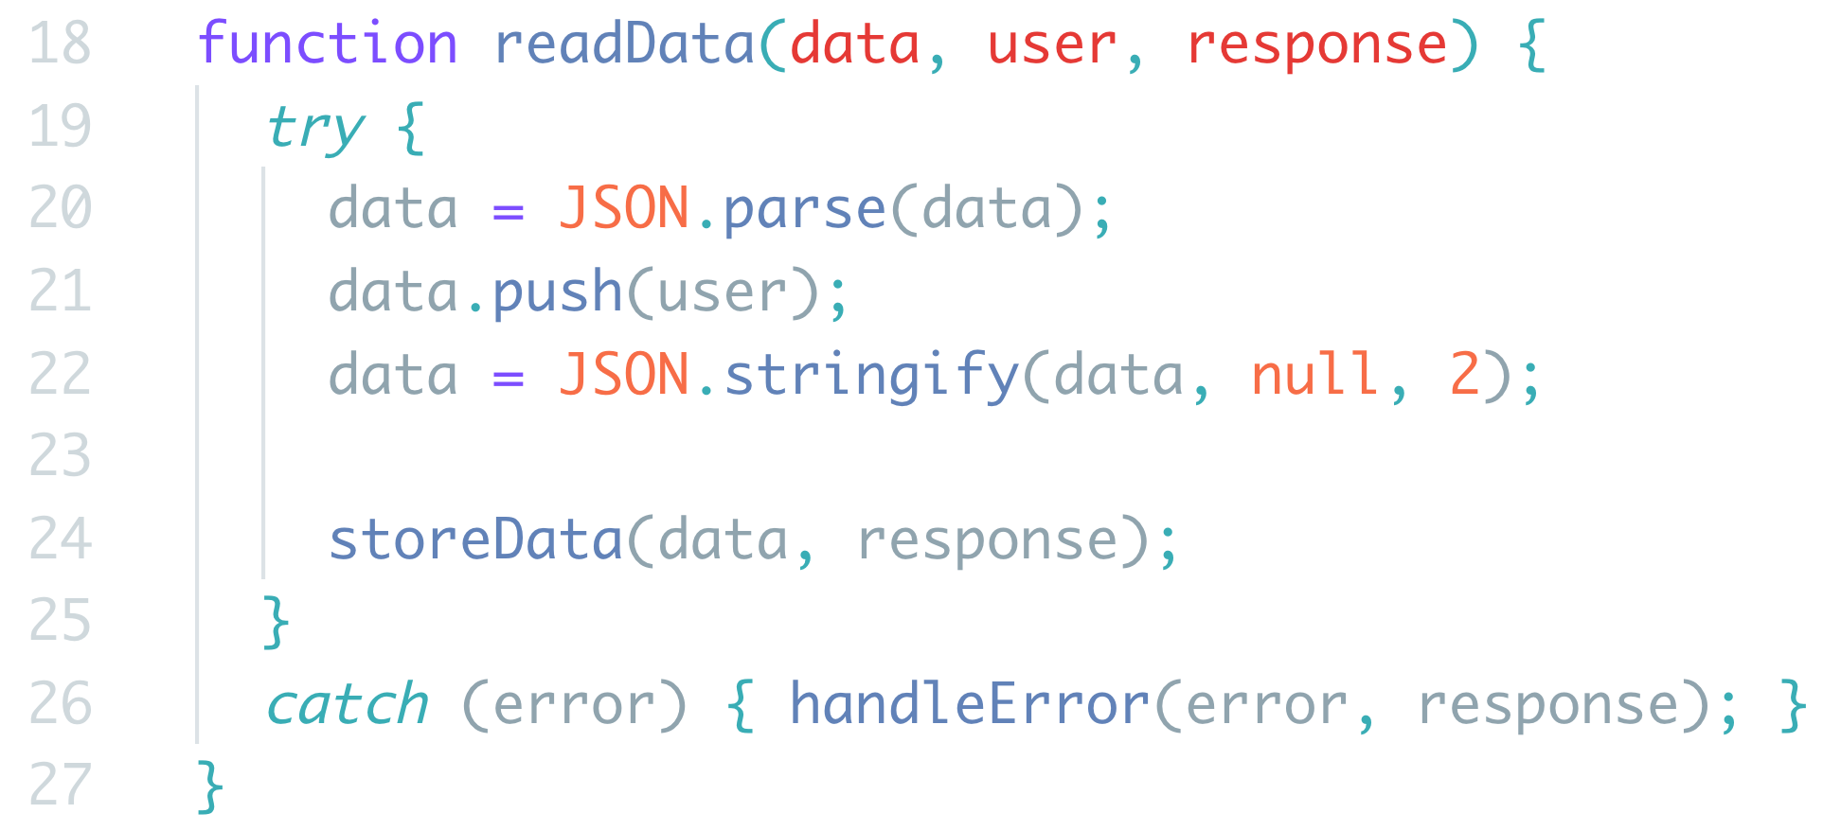
Simple API 2.0

Slide 16
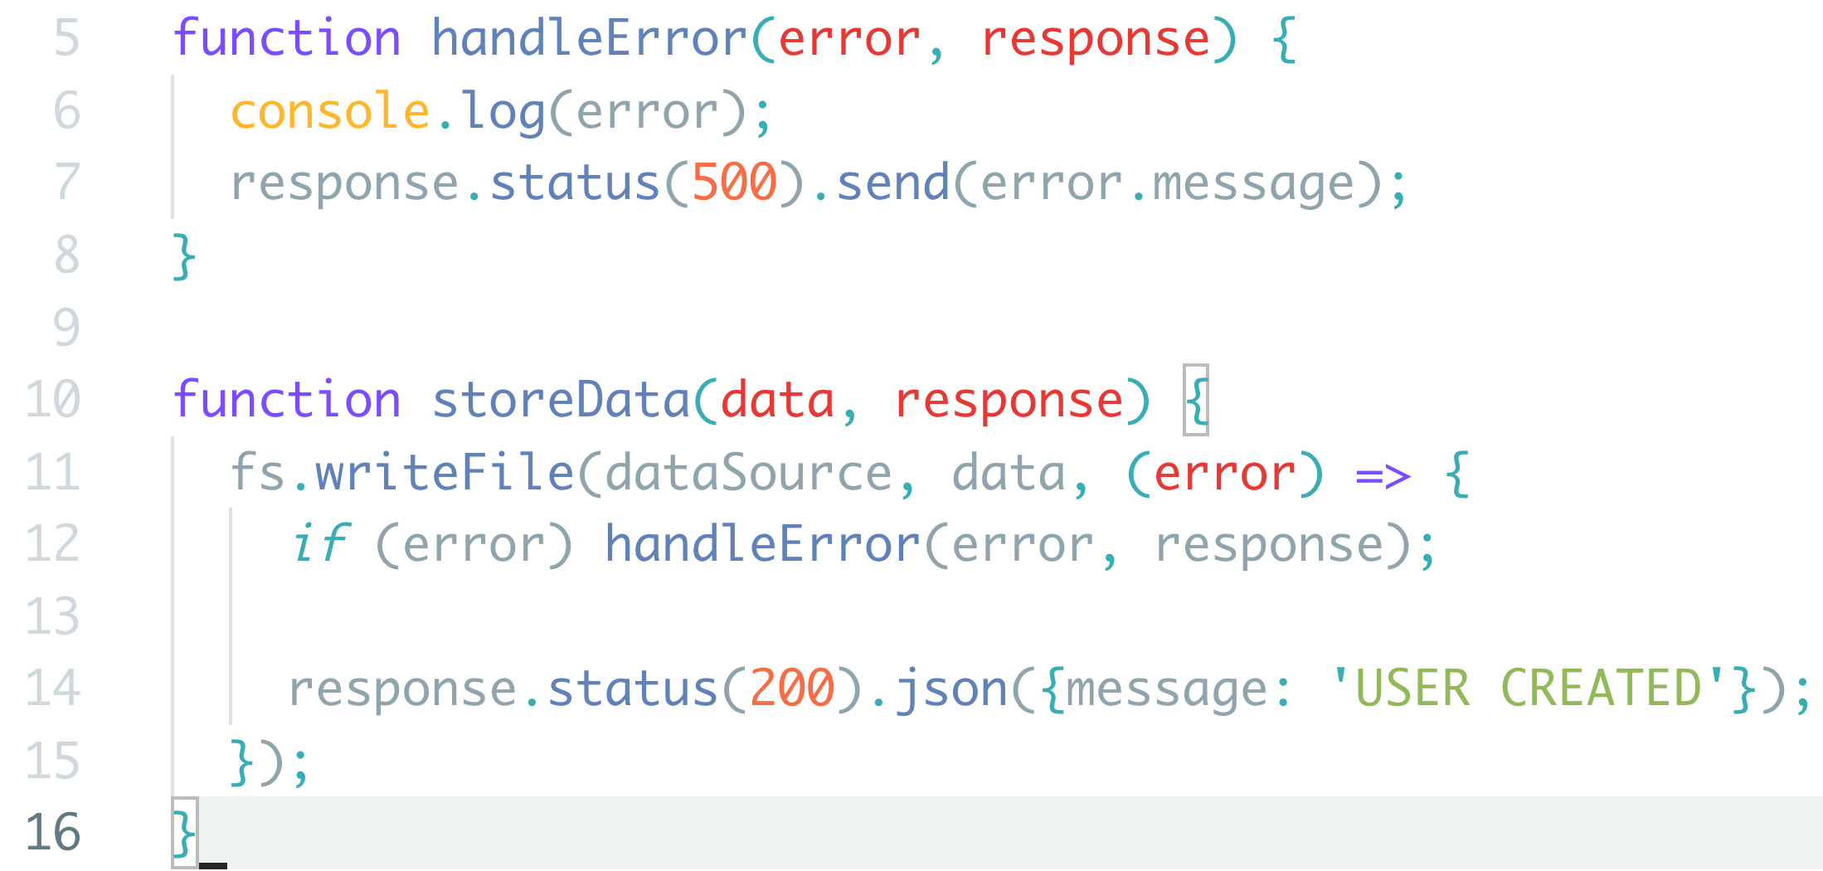
Simple API 2.0

Slide 17
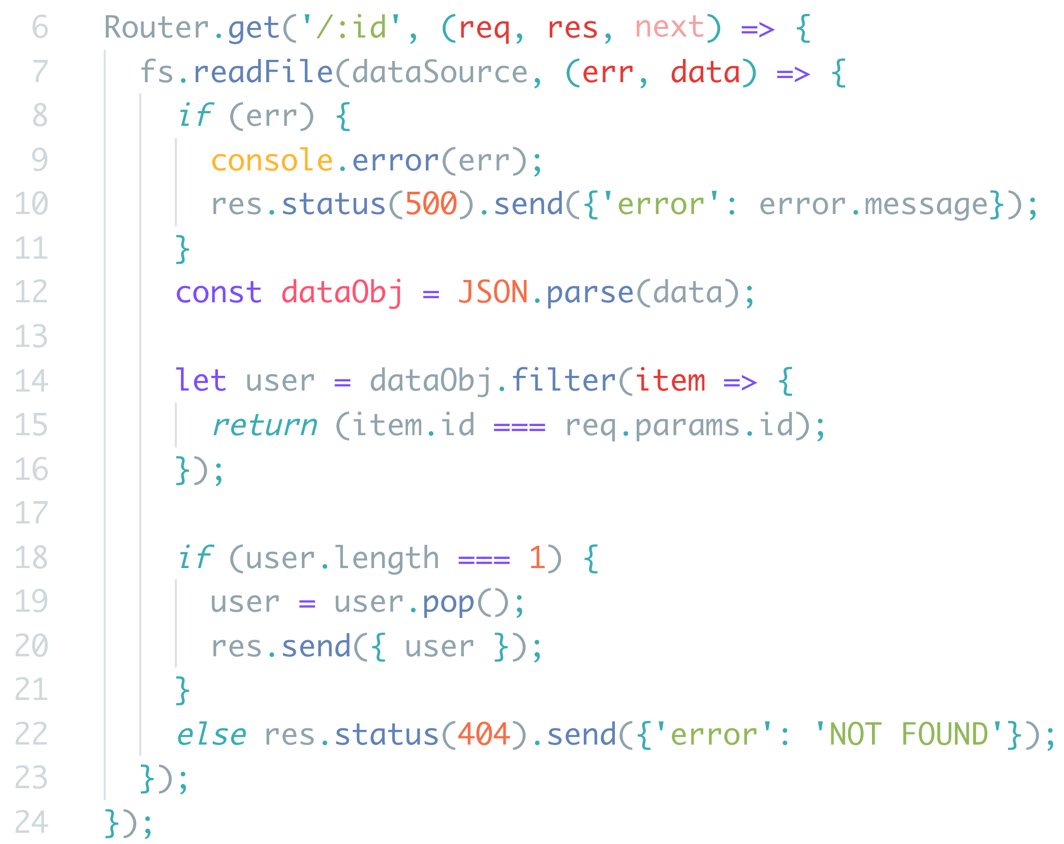
Simple API 2.0
Back to read.js, let’s add one more endpoint.
This endpoint will return single user data according to user id.
Did anyone manage to return any user data?
Did anyone encounter HTTP error 500 or 404?

Slide 18
Exercise
Using similar logic with create and read data source, your task is to code the following endpoints:
UPDATE existing data source.
DELETE existing data source.
Good luck!

Slide 19

THANK YOU

